Slide 1
Storage and Indexing
Instructor: Kazi Amit Hasan

Slide 2
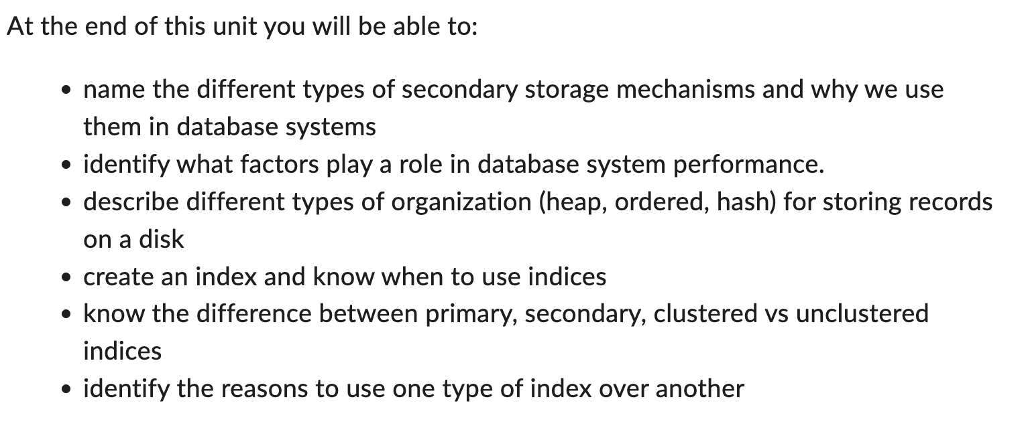
Storage and Index

Slide 3
Data Storage
When a user asks for data, the system should return it as fast as possible.
SELECT * FROM student WHERE id = 1001;
The database should find that row quickly, not scan millions of records slowly.
How fast this happens depends on how the data is stored.

Slide 4
How Data is Stored Depends on Workload
Workload = the type of operations the database performs most often.
READ : retrieve data (SELECT)
Write: Insert/update (INSERT, UPDATE, DELETE)
If the workload is mostly read:
Ex: Google Search
SELECT * FROM products WHERE name = 'iphone’
Goal: find the data very fast
So we add indexes
For read heavy systems, indexes are great

Slide 5
How Data is Stored Depends on Workload
If the workload is mostly write:
Ex: Bank transaction system
INSERT INTO transactions UPDATE account_balance
If we have many indexes, it will become slower
So we should use fewer indexes

Slide 6
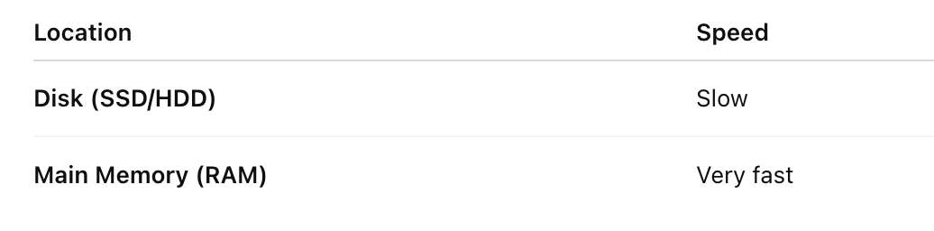
Data is fetched from disk into main memory for processing.
Goal: keep the data most likely to be accessed in main memory

Slide 7
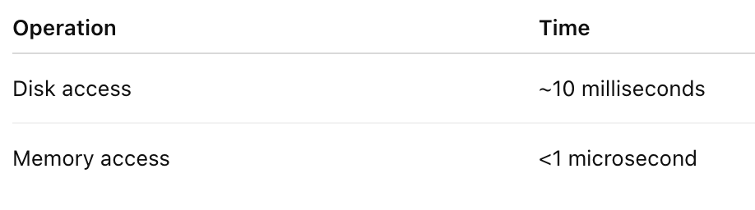
The physical characteristics of storage devices play a major role in retrieval efficiency
accessing a random piece of data on disk takes much longer (10s of milliseconds) than from main memory (fraction of a microsecond)

Slide 8
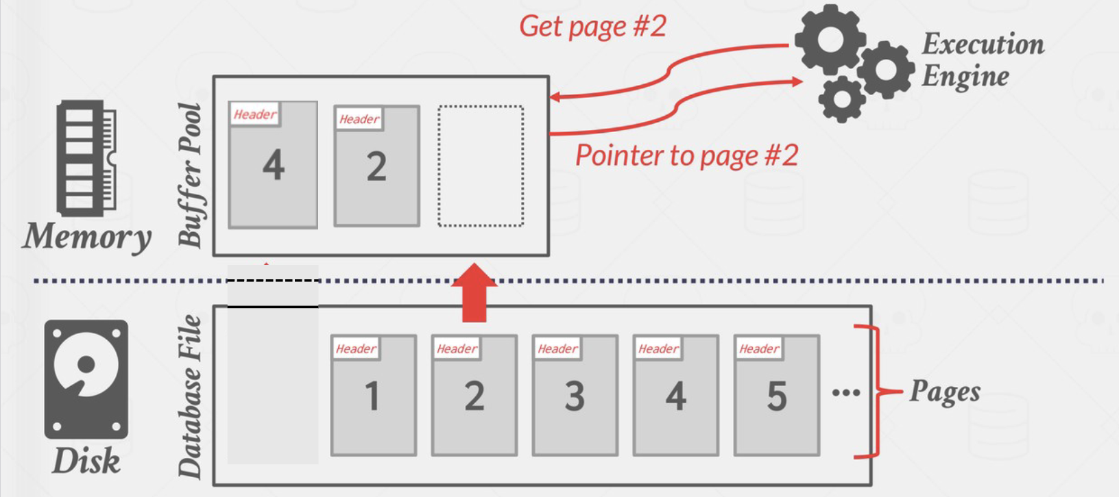
Data Access Within the DBMS
In a database, all data is stored on disk.

Slide 9
Data Access Within the DBMS
Data is stored in “pages”
1 page = many rows

Slide 10
Data Access Within the DBMS
Pages are on disk

Slide 11
Data Access Within the DBMS
RAM has a buffer pool. RAM keeps some pages temporarily.

Slide 12
Data Access Within the DBMS
Get Page 2

Slide 13
Data Access Within the DBMS
Database tries to keep frequently used pages in RAM.

Slide 14
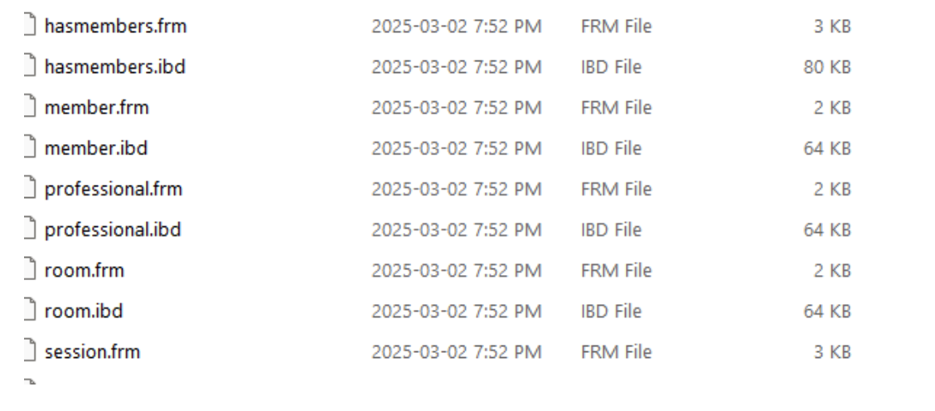
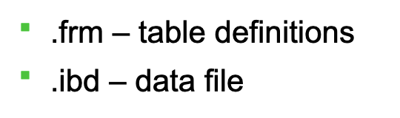
Database Files
a database is mapped to a number of different files (maintained by the OS)
CREATE DATABASE conferencedb;
The DBMS does not store it as one big object.
Instead, it creates multiple files on disk.
xampp/mysql/data/conferencedb/

Slide 15
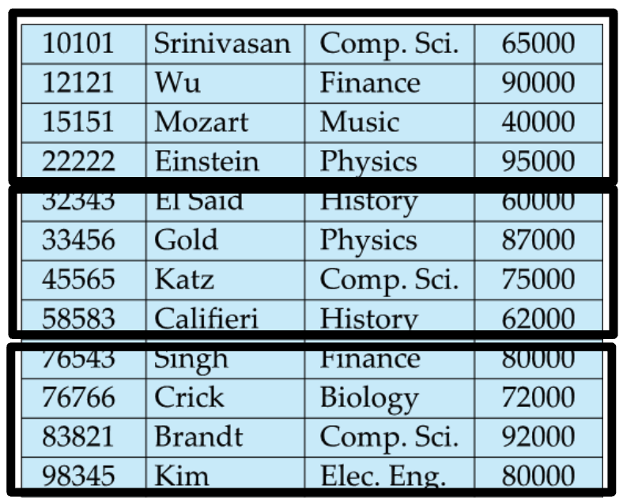
Database Files
file is organized logically as a sequence of records (tuples)
which is then logically partitioned into fixed length "blocks”
we will consider 1 page = 1 block for the purpose of this lecture
Disk reads data in chunks, not single rows.
When reading from disk, the DBMS loads entire pages, not single rows

Slide 16
Organization of Records in Files
Heap – record can be placed anywhere in the file where there is space
Sequential – store records in sequential order, based on the value of some attribute ("search key") of each record
Multitable clustering file organization - records of several different relations can be stored in the same file
Motivation: store related records on the same block to minimize I/O
B+ tree file organization
Ordered storage; tree structure
Hashing – a hash function computed on search key; the result specifies in which block of the file the record should be placed

Slide 17
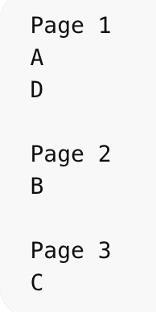
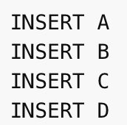
Heap
record can be placed anywhere in the file where there is space
No order at all!
New rows are just placed wherever there is free space.
Very fast insert
Searching is slow (may scan entire table)
SELECT * FROM student WHERE id = 500
Database may need to scan every page.

Slide 18
Heap
Records usually do not move once allocated (although if deleted, there will be free space where the record once resided)
Important to be able to efficiently find free space within file
not beneficial for sequential accesses – for instance, find all instructors with names starting from B to L.

Slide 19
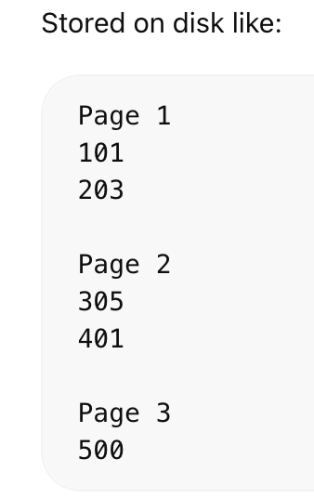
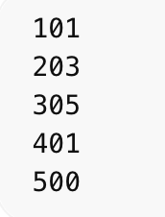
Sequential File Organization
Records are stored sorted by a key.
Faster searching
Good for range queries
Insert is slower (must keep order)

Slide 20
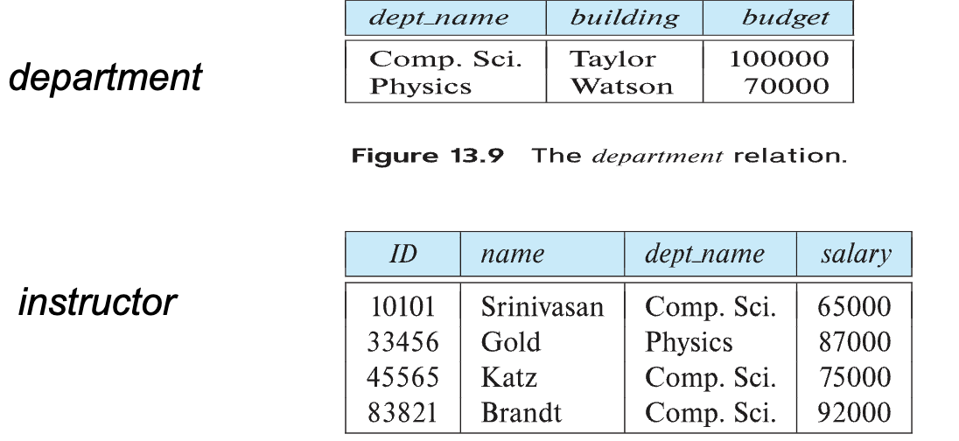
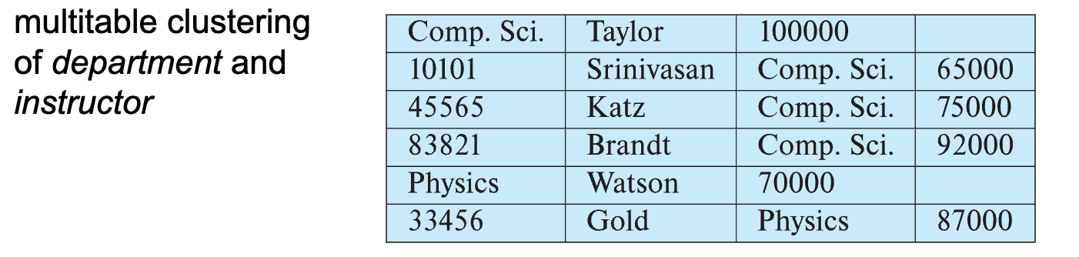
Multitable Clustering File Organization
Store several relations in one file using a multitable clustering file organization

Slide 21
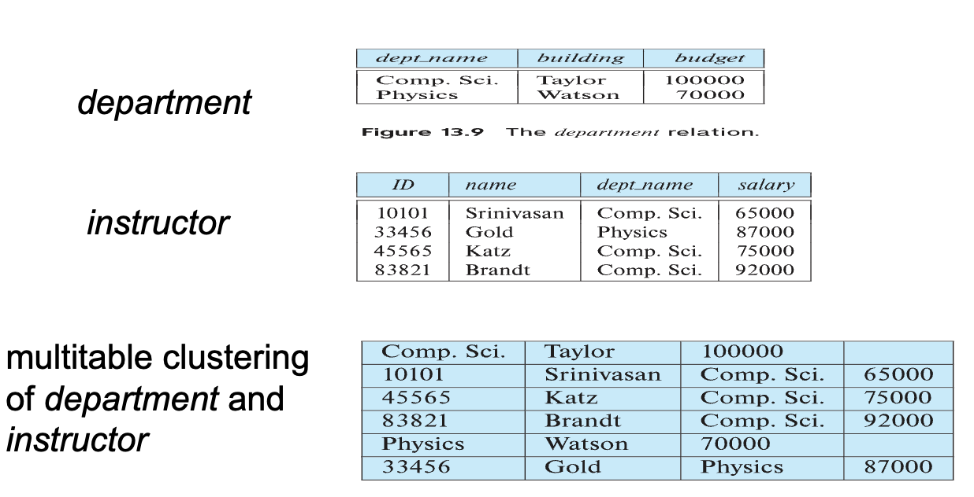
Multitable Clustering File Organization (cont.)
good for queries involving department ⨝ instructor, and for queries involving one single department and its instructors
bad for queries involving only department

Slide 22

Multitable Clustering File Organization (cont.)
Why we do this? To reduce disk reads
Both records are already in the same page.
So fewer disk reads → faster.

